Slide 1
Common Stock and Investment Banking Process
Features of common stock;
Legal rights and privileges of common stock holders;
Advantages and Disadvantages;
The market for common stock;
Method of selling securities: public offering, right offering and private placement;
Analysis of right offering on shareholders’ wealth;
The investment banking process

Slide 2
Features of Common Stock
Par Value
Maturity
Claim on Income and Assets
Voting Rights
Preemptive Rights
Limited Liability
Classified Common Stock

Slide 3
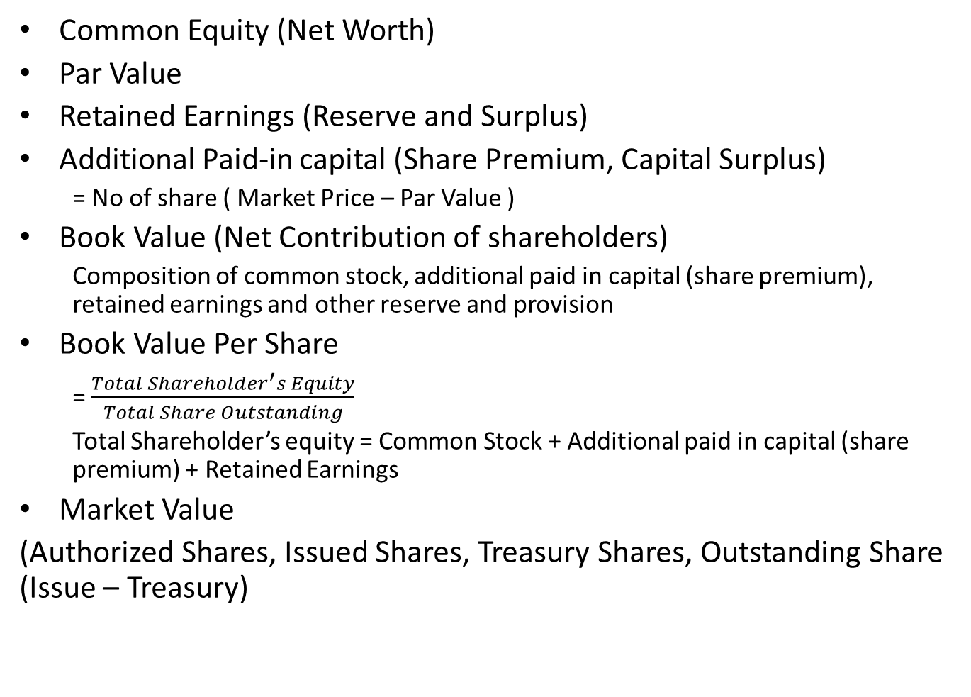
Balance Sheet Accounts
Common Equity (Net Worth)
Par Value
Retained Earnings (Reserve and Surplus)
Additional Paid-in capital (Share Premium, Capital Surplus)
= No of share ( Market Price – Par Value )
Book Value (Net Contribution of shareholders)
Composition of common stock, additional paid in capital (share premium), retained earnings and other reserve and provision
Book Value Per Share
= $\frac{Total Shareholder^{′}s Equity}{Total Share Outstanding}$
Total Shareholder’s equity = Common Stock + Additional paid in capital (share premium) + Retained Earnings
Market Value
(Authorized Shares, Issued Shares, Treasury Shares, Outstanding Share (Issue – Treasury)

Slide 4
Right and Privileges of Common Stockholders
Collective Right
Right to amend the charter
Right to adopt and amend bylaws
Right to elect directors
Right to authorize the sale of fixed assets
Right to enter into merger
Right to change the amount of authorized common stock
Right to issue preferred stock, debenture and other securities
Specific Right
Right to Vote
Right to sell Stock Certificate
Right to inspect corporate Bonds
Right to residual income and assets
Preemptive Right

Slide 5
Voting Right
Two Types
Majority Voting System (Non Cumulative)
One vote for each of the directorship seats
If 200 shares and 7 seats = 1400 votes
Stockholders who control more than 50 percent shares can elect all members.
Cumulative Voting System
May cast any or all of votes to single director
1400 votes of above case may be distributed in any way or to single director also
Gives Minority groups to obtain some voice in control of company
In Nepal, according to Company Act 2063, election of BOD should be in Cumulative Voting System

Slide 6
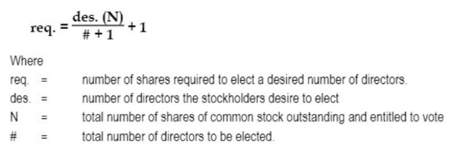
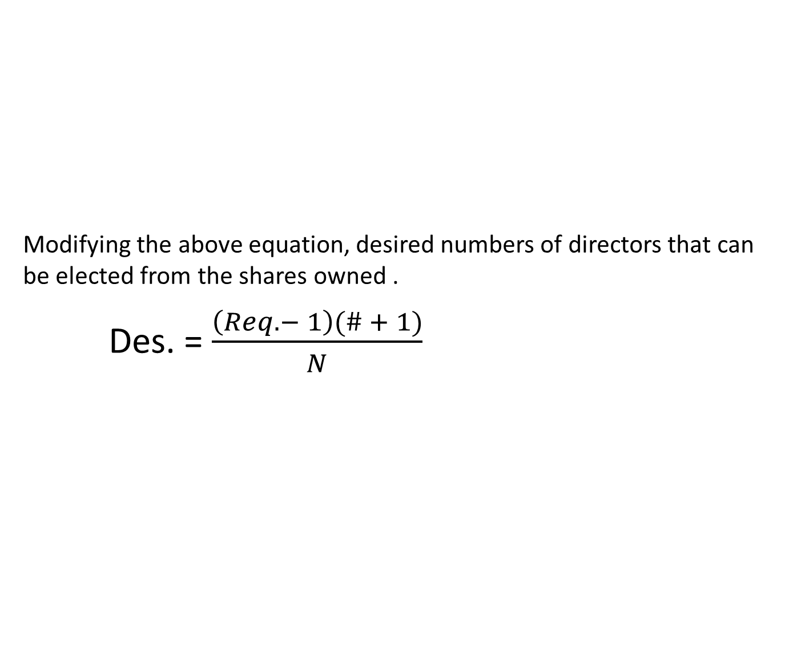
Voting Right
Modifying the above equation, desired numbers of directors that can be elected from the shares owned .
Des. = $\frac{\left(Req. − 1\right)(\# + 1)}{N}$

Slide 7
Example Problem
As one of the minority shareholders of the Sony Corporation, you are dissatisfied with the current operations of the company. You feel that if you could gain membership on the company’s board of directors, you could persuade the company to make improvements. The problem is that the current management controls is 75 percent of the stock, you control only 7 percent and the balance is held by other minority shareholders. There are a total of 500,000 voting right shares. Ten directors will be elected at the next annual stockholders meeting.
If voting is non cumulative, can you elect yourself director ?
Suppose, you are able to persuade all the minority shareholders that you should elect. If voting is non cumulative, can they elect you ?
If Voting is cumulative, can you elect yourself director ?
What percentage of minority shares other than your own will you need to have for you to be certain of election ?
What is the numbers of directors, the minority shareholders can elect with certainty ?

Slide 8
Advantages and Disadvantages of Common Stock
From Issuer’s Viewpoint
Advantages:
Minimum Restriction
Increase in Borrowing Capacity
Maturity
Sell Easily
Lower Tax
Disadvantages:
Control
High Cost of Capital
Need to share Earning and Capital Gain
Lack of Tax Saving
Higher Cost of Underwriting
No Flexibility

Slide 9
Advantages and Disadvantages of Common Stock
2. From Investors Viewpoint
Advantages:
More Income
Participation in Management
Appealing to Speculators
Disadvantages:
Irregular Income
Loss in Business Cycle
Loss in Liquidation
Question: What might be advantages of common stock from Social view point ?

Slide 10
The Market for Common Stock
Primary Market
Private Placement
Public Offering
Right Offering
Secondary Market
Organized Stock Exchange
Over-The-Counter (OTC) Market

Slide 11
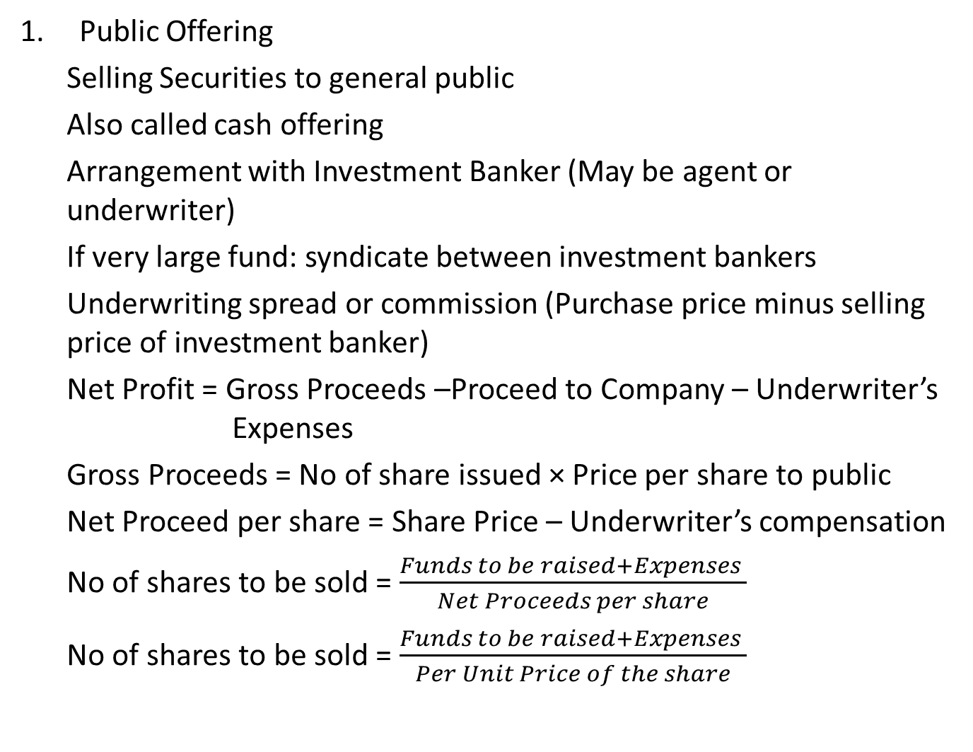
Methods of Selling Securities
Public Offering
Selling Securities to general public
Also called cash offering
Arrangement with Investment Banker (May be agent or underwriter)
If very large fund: syndicate between investment bankers
Underwriting spread or commission (Purchase price minus selling price of investment banker)
Net Profit = Gross Proceeds –Proceed to Company – Underwriter’s Expenses
Gross Proceeds = No of share issued × Price per share to public
Net Proceed per share = Share Price – Underwriter’s compensation
No of shares to be sold = $\frac{Funds to be raised+Expenses }{Net Proceeds per share}$
No of shares to be sold = $\frac{Funds to be raised+Expenses }{Per Unit Price of the share}$

Slide 12
Public Offering
Example Problem:
Kathmandu Finance Company specializes in underwriting new issues by manufacturing firms. On a recent offering of Noori Agro Company Limited, the terms were as follows :
Price to Public : Rs 5 per share
Number of Shares: 3 million
Proceeds to Company: Rs 14 million
The out of pocket expenses incurred by Kathmandu Finance Company in the design of the new issue were Rs 3,000,000. What profit or loss would Kathmandu Finance Company incur if the issue were sold to the public at an average price of :
Rs 5 per share
Rs 7 per share
Rs 3 per share

Slide 13
Public Offering
Advantages:
Different Sources
Publicity
Wider Participation
Advantage of Competition
Disadvantages:
High Issuing Cost
Delay
Opportunity

Slide 14
Private Placement
Selling securities privately to the limited numbers of investors
Also known as direct placement or private sale
Direct negotiation between investors and issuing firms
Used in the sale of Preferred Stocks and Bonds
Advantages:
Tailor Made
Ease of Sale
Less Time Consuming
Lower Cost
Secrecy
Flexibility
Benefits to Small Firms
Disadvantages:
Resale Limited
Concentration of Economic Power
High Interest Cost

Slide 15
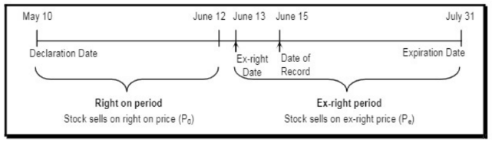
Right Offering
Offering new common stock to existing shareholders at a subscribed price on pro-rata basis
Also known as privileged subscription or right issue.
Protects existing shareholders from dilution in wealth and control power
Helps to reduce flotation cost
Purpose of Preemptive Right
Protect the power of control of present stockholders
Protect stockholders against dilution of wealth
Easier way to raise new equity capital

Slide 16
Analysis of Right Offering
What should be subscription price ?
How many shares will have to be sold ?
How many right are required to purchase one new share ?
What will be the value of right ?
What will be the share price after issue ?
What will be the effect of rights offering on shareholder’s wealth ?
What will be the effect of right offering on company’s balance sheet and income statement ?

Slide 17
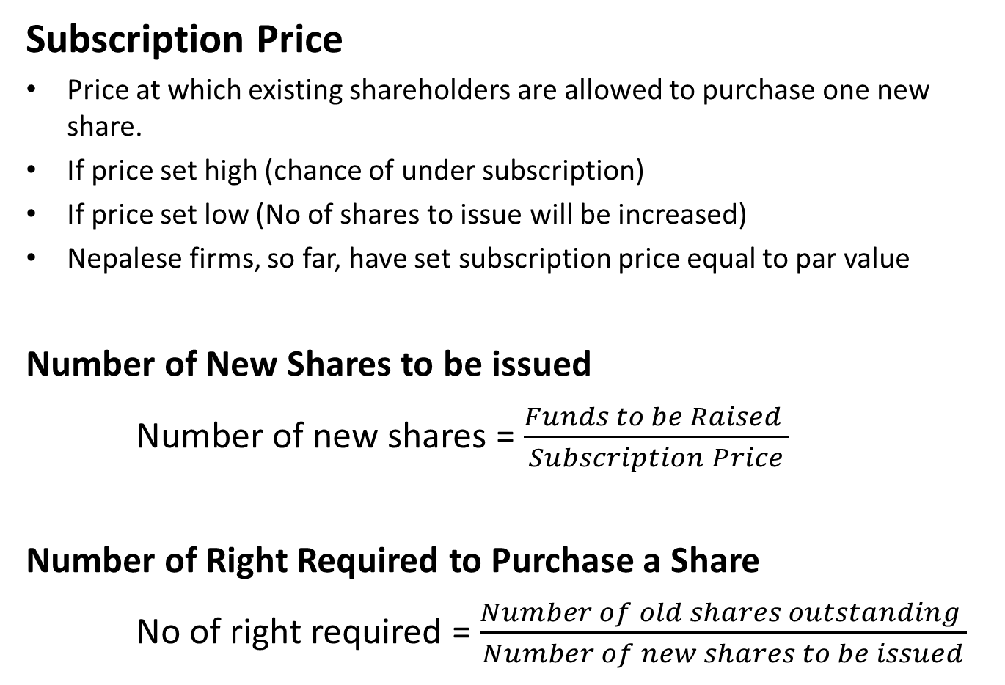
Analysis of Right Offering
Subscription Price
Price at which existing shareholders are allowed to purchase one new share.
If price set high (chance of under subscription)
If price set low (No of shares to issue will be increased)
Nepalese firms, so far, have set subscription price equal to par value
Number of New Shares to be issued
Number of new shares = $\frac{Funds to be Raised }{Subscription Price}$
Number of Right Required to Purchase a Share
No of right required = $\frac{Number of old shares outstanding }{Number of new shares to be issued}$

Slide 18
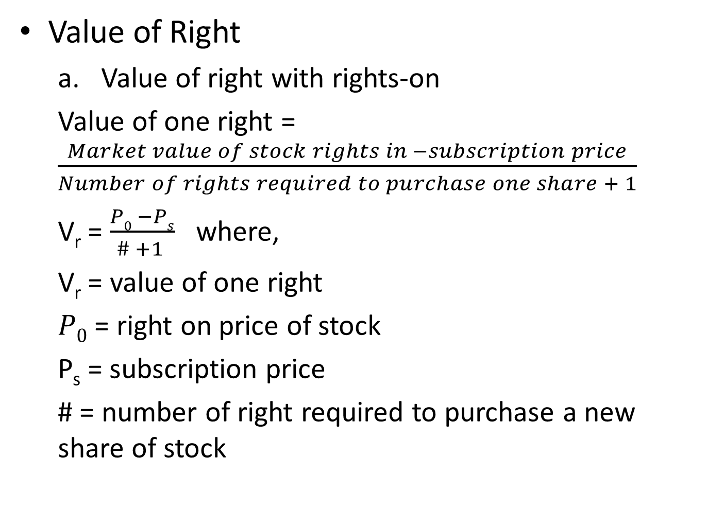
Analysis of Right Offering
Value of Right
Value of right with rights-on
Value of one right = $\frac{Market value of stock rights in −subscription price}{Number of rights required to purchase one share + 1}$
V_{r} = $\frac{P0 −Ps}{\# +1 }$ where,
V_{r} = value of one right
$P0$ = right on price of stock
P_{s} = subscription price
# = number of right required to purchase a new share of stock

Slide 19
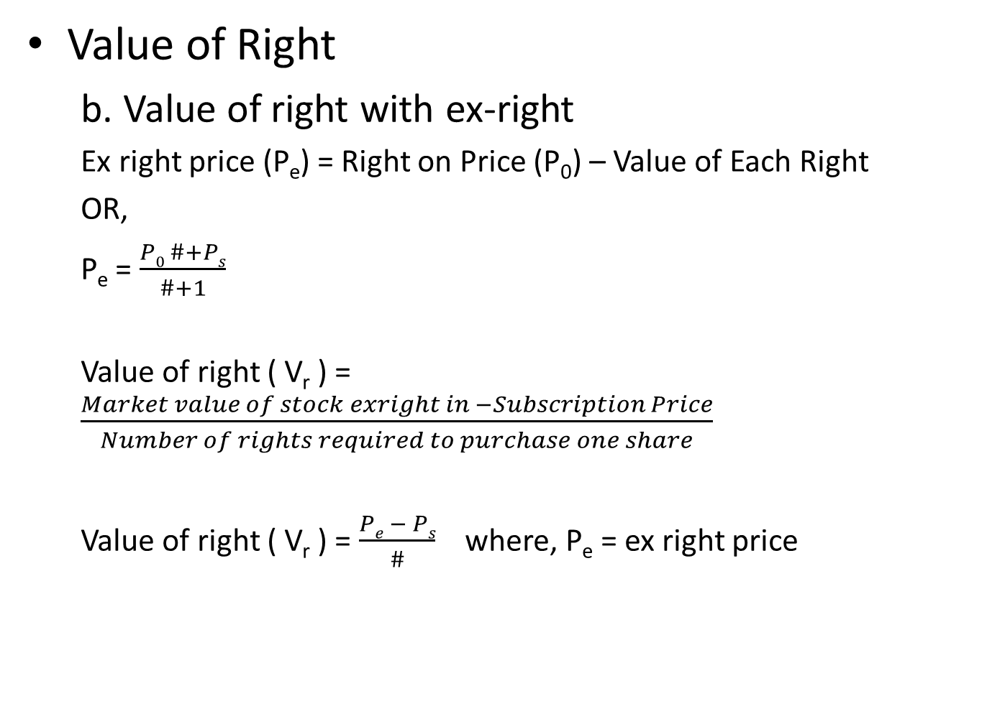
Analysis of Right Offering
Value of Right
b. Value of right with ex-right
Ex right price (P_{e}) = Right on Price (P₀) – Value of Each Right
OR,
P_{e} = $\frac{P0 \#+Ps}{\#+1}$
Value of right ( V_{r} ) = $\frac{Market value of stock exright in −Subscription Price}{Number of rights required to purchase one share}$
Value of right ( V_{r} ) = $\frac{Pe − Ps}{\#}$ where, P_{e} = ex right price

Slide 20
Effects of Rights Offering on Stockholders Wealth
We shall proceed this topic taking numerical example in the class.

Slide 21
Investment Bankers
Financial Middlemen in security offering process
Financial Institution that underwrites and distributes new investment securities and helps business obtain financing.
Provides valuable suggestions for issuing companies and assists in the preparation of new issue
Investment Bankers are neither investors nor bankers
Functions of Investment Bankers
Underwriting
Distribution
Advising
Making a Market

Slide 22
Investment Banking Process
Raising Capital: Stage I Decisions
Amount to be raised
Type of Securities Used
Competitive Bid Versus Negotiated Deal
Selection of Investment Banker
Raising Capital: Stage II Decisions
Reevaluating the initial decision
Best Efforts or underwritten Issues
Issuance Costs
Setting the Offering Price
Selling Procedures
Shelf Registration
Maintenance of the Secondary Market

Slide 23
Investment Banking Process
On other way…
Selecting an investment banker
Discussing with the issuer
Syndicating the underwriting
Forming a selling group
Fulfilling legal requirements
Pricing the Issues
Distributing the Issue
Stabilizing the Price

